Slide 1
Raw data from online news portal
Data Cleaning
Randomly
Split Data
Select Algorithm
Test Set (20%)
Train Set (80%)
Final Model Evaluation
Data Preprocessing
Final Model
Training
Predictions of new data

Slide 2
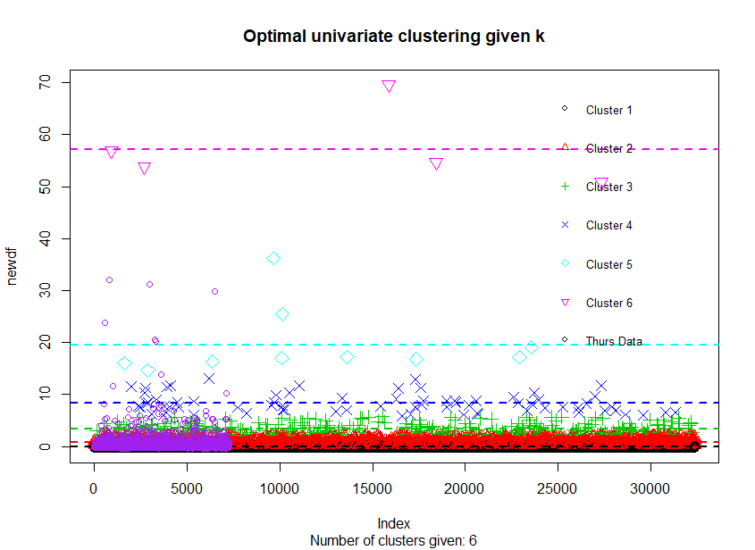
Raw data from online news portal
Data Cleaning
Algorithm Selection
Feature Selection
Cluster Validation
Results Interpretation
Knowledge

